Slide 1

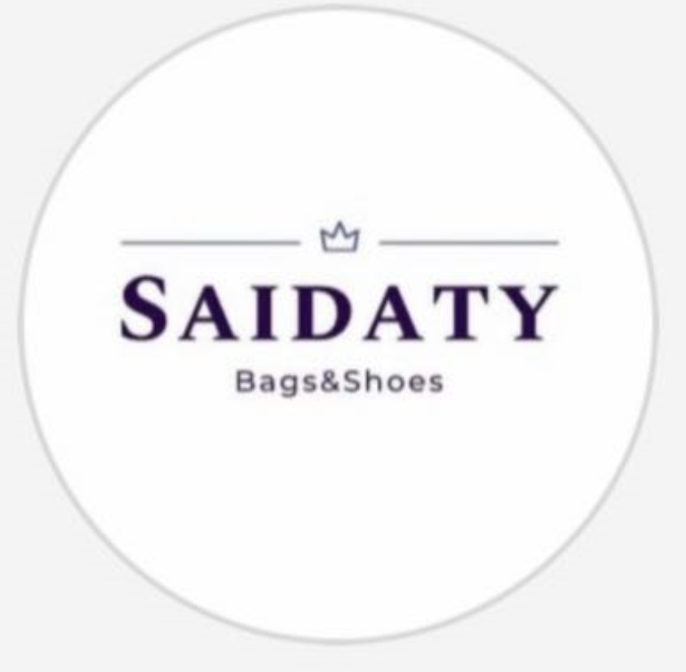
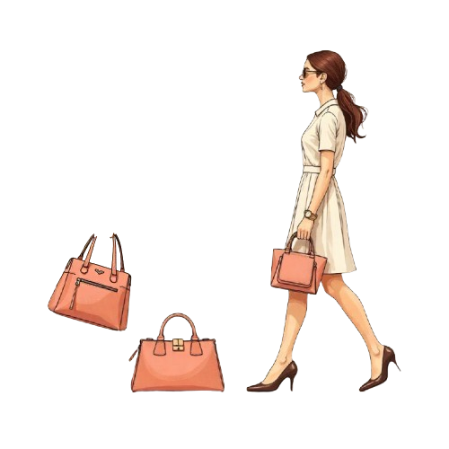
MARKETING
PLAN
SAIDATY
Bags & Shoes
1
NOVEMBER 2025
PRESENTED BY:SAIDATY MARKETING TEAM

Slide 2

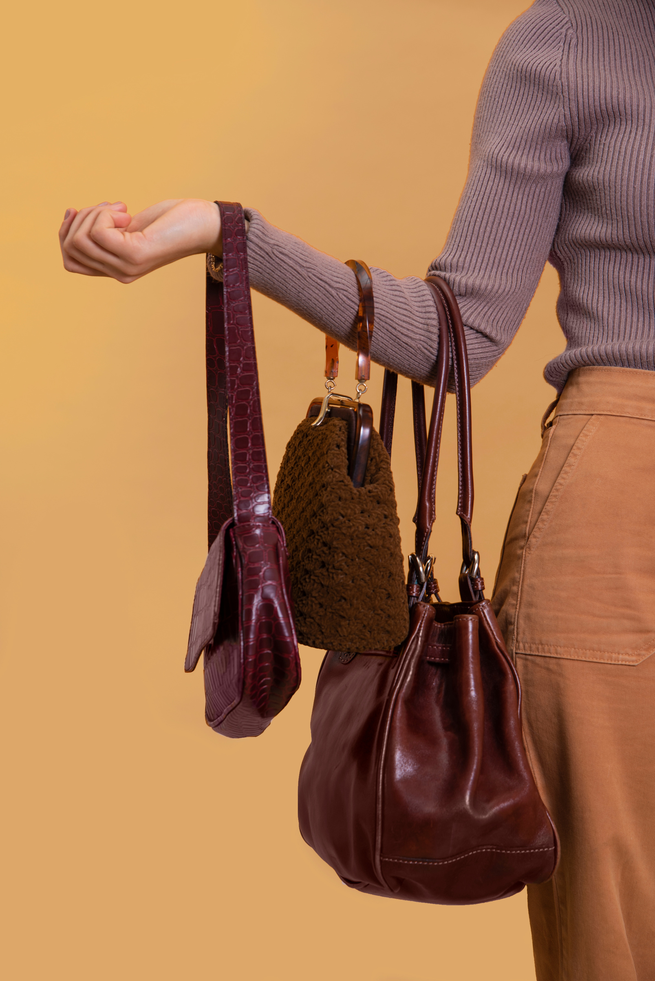
CREATIVE BRIEF
AGENDA
Brand Overview
Business model Canvas
Sostac
Implementation Plan
Analysis
Recommendations
2

Slide 3

CREATIVE BRIEF
BRAND OVERVIEW
Saidaty is a modern fashion brand specializing in shoes and bags, available both online and offline.
The brand focuses on providing high-quality, imported collections at competitive prices, making stylish fashion accessible to everyone.
Key Advantages:
Competitive and affordable prices
Wide range of imported designs
Physical store and online presence
Fast and reliable delivery service
Saidaty aims to combine elegance, variety, and convenience for every customer.
3

Slide 4

CREATIVE BRIEF
BUSINESS MODEL CANVAS
Customer Segmentations:
Channels:
Customer relationships
• University girls and young women (18–45 years old).
• Working women looking for stylish and affordable bags and shoes.
• Brides and customers shopping for special occasions.
• Online shoppers across Egypt (mainly Instagram & TikTok users).
• Fast replies to messages and comments.
• Attractive and trendy content showcasing new arrivals.
• Loyalty offers and discounts for returning customers.
• Interactive posts (stories, polls, outfit ideas).
• Physical store in Helwan.
• Social media pages: Instagram – TikTok – Facebook.
• Paid social media ads.
Value Propositions:
Key Resources:
Key Activities
• Trendy and fashionable bags and shoes at affordable prices.
• Wide variety of styles to fit all tastes and occasions.
• Good quality products with competitive pricing.
• Fun and easy shopping experience in-store and online.
• Product Selection.
• Marketing and Advertising.
•Order Fulfillment.
• Collaborating with influencers and engaging with followers.
• Reliable bag and shoe suppliers.
• Instagram page and digital presence.
• Sales and customer service team.
• Professional photography and marketing content.
4

Slide 5
CREATIVE BRIEF
BUSINESS MODEL CANVAS
Key Partners:
Cost Structure:
Product Suppliers and wholesalers
Shipping and delivery companies
Local Fashion Influencer
• Advertising and marketing costs.
• Product purchasing and inventory costs.
• Staff salaries or sales commissions.
• Delivery and packaging expenses.
• Store rent, utilities, and decor costs.
Revenue Streams:
• In-store sales.
• Online sales through Instagram and TikTok.
• Custom orders or special product requests.
• Seasonal offers and promotions to attract new customers.
5

Slide 6
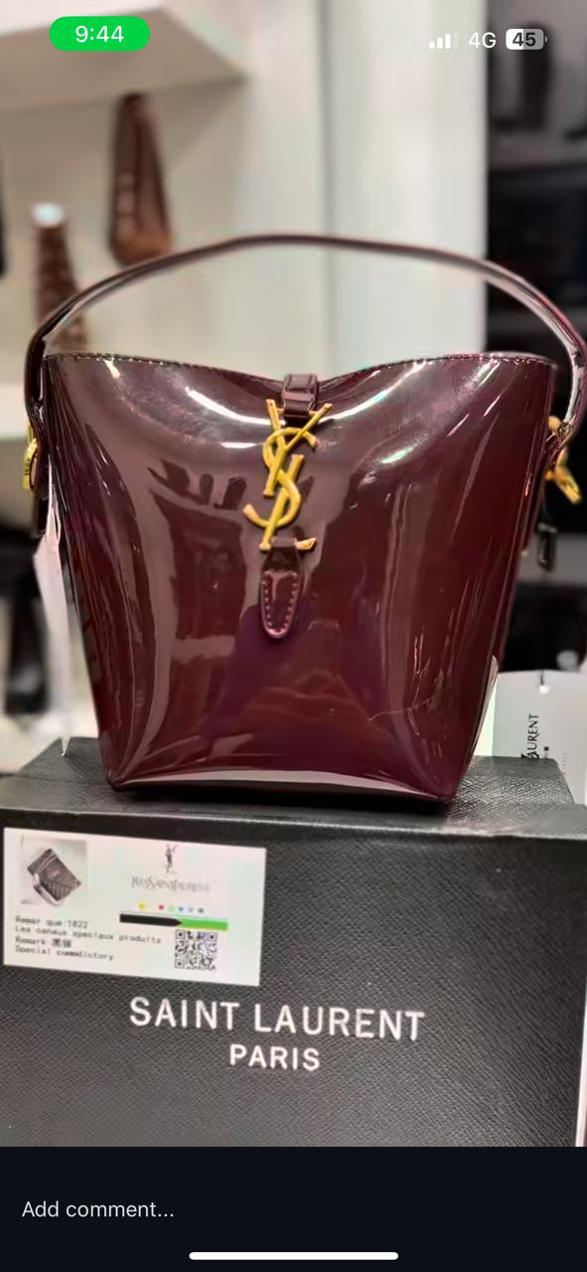
CREATIVE BRIEF
SITUATION ANALYSIS
The situation analysis provides a comprehensive overview of Saidaty’s current position in the market.
It examines the brand’s internal Analysis, target customers’ behaviors, and the competitive Analysis, ending with a full SWOT analysis.
This step helps us clearly understand where Saidaty stands today, identify strengths and weaknesses, and set the foundation for our future strategies and action plans.
6

Slide 7

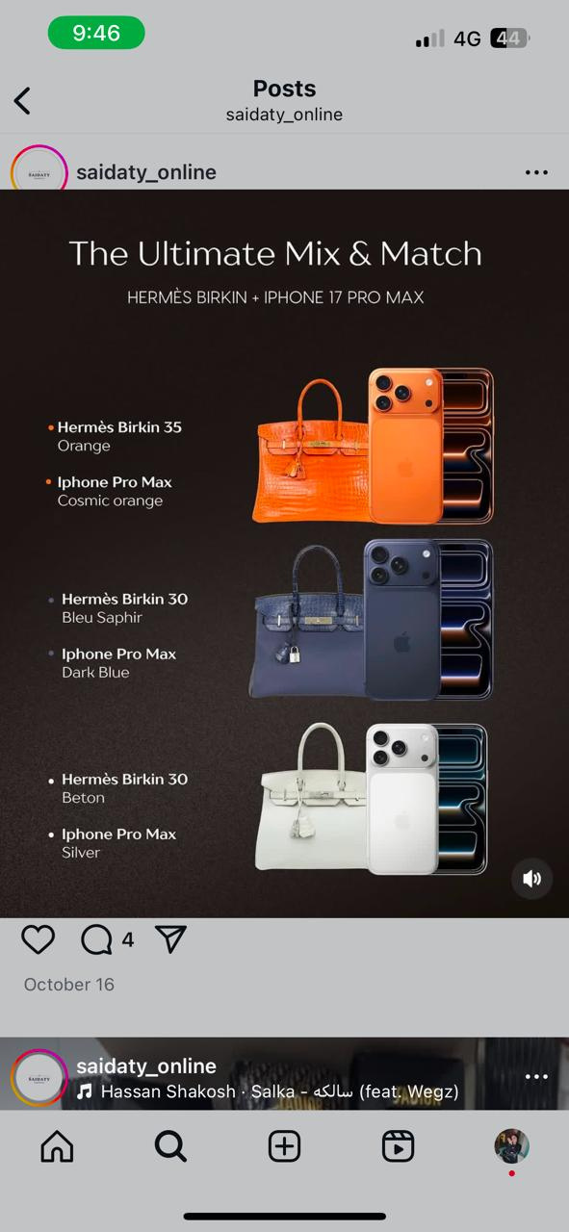
CREATIVE BRIEF
INTERNAL ANALYSIS
Saidaty offers trendy, high-quality shoes and bags at affordable prices.
The brand has a strong social media presence and active participation in local events, but it still needs a clearer visual identity and more diverse promotional strategies.
7

Slide 8

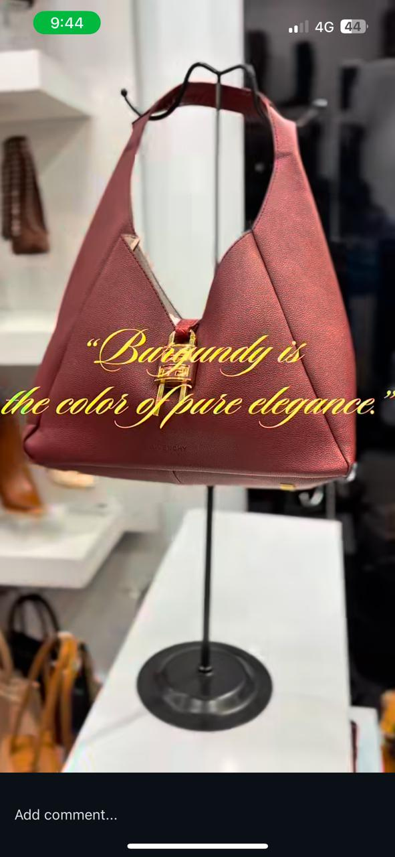
CREATIVE BRIEF
COMPETITOR ANALYSIS
The market includes several local and online competitors offering similar products.
While some focus on price, others emphasize exclusivity.
Saidaty’s opportunity lies in balancing both, affordable pricing with stylish, premium presentation.
Competitive Analysis Link
8

Slide 9
CREATIVE BRIEF
COMPETITOR ANALYSIS
Aseel | Villa Kout
Strengths: Clear brand positioning: “Your one-stop shop for stylish shoes and bags.” Strong social media presence: 102K followers. High engagement rate: 84%. Active use of video content: Reels + short videos. Friendly communication style. Professional presence with a website, making shopping easier. Consistent posting schedule: 1 post per week. Weaknesses: Limited posting frequency (1 post per week) compared to more active competitors. Product range limited to shoes and bags, restricting potential audience. No visible customer reviews or ratings, which may reduce trust. Relies mostly on social media for sales; limited use of other sales channels. | Strengths: Clear specialization in women’s bags and accessories. High-quality, elegant, and feminine product photography. Consistent visual identity with unified logo and colors. Varied content: short videos (reels), bag photos, offers, and new products. Clear CTAs: “Order Now”, “Contact Us”, “Share to reach your friends”. Organic presence without paid ads. Multiple contact options: Message, Phone, WhatsApp. Weaknesses: Low follower count (~4,700). Irregular posting; no posts since Feb 2025. Limited engagement: 40–120 likes, 5–15 comments, 3–8 shares. Minimal use of paid advertising. Limited Stories and other interactive content. Medium responsiveness to comments; some are unanswered.
9

Slide 10
CREATIVE BRIEF
COMPETITOR ANALYSIS
Beauty Bar Store
Strengths: Specialized in selling branded bags and shoes at discounted prices, focusing on luxury and style. Regular posting schedule: 2–4 posts per week. Strong social media presence: 71K followers. Good engagement per post: ~300–800 likes, 20–60 comments, 1–2 shares. Uses short videos (Reels), product photos, offers, and discounts effectively. Friendly and persuasive marketing tone. Clear calls-to-action (CTAs): “Order Now”, “Message Us”, “Up to 70% off”. Targets consideration and purchase stages of the buyer journey. Weaknesses: No visible reviews on the page, which may reduce trust for new customers. Replies to messages are inconsistent; sometimes quick, sometimes delayed. Overreliance on discounts. Content can be repetitive; limited caption diversity. Needs more diverse and engaging content strategy despite visually successful page.
Competitive Analysis Link
10

Slide 11

CREATIVE BRIEF
SWOT ANALYSIS
STRENGTHS
WEAKNESSES
OPPORTUNITIES
THREATS
DIVERSE PRODUCT RANGE CATERING TO VARIOUS NEEDS (CASUAL, EVENING WEAR, COMPLETE SETS).
OFFERING THE LATEST MODELS ALIGNED WITH GLOBAL FASHION TRENDS.
HIGH-QUALITY HIGH-COPY PRODUCTS CLOSELY RESEMBLING ORIGINALS.
WIDE SELECTION OF SIZES AND COLORS TO SUIT A BROAD CUSTOMER BASE.
EASY ACCESSIBILITY TO PRODUCTS VIA PHYSICAL STORE AND SOCIAL MEDIA CHANNELS.
ACTIVE PARTICIPATION IN BAZAARS AND EVENTS TO INCREASE BRAND EXPOSURE.
CONTINUOUS ENGAGEMENT ON SOCIAL MEDIA THROUGH REGULAR POSTING OF PHOTOS AND VIDEOS.
INABILITY TO EXPAND INTO ORIGINAL PRODUCTS DUE TO HIGH COSTS.
INADEQUATE RESPONSES TO CUSTOMER COMMENTS (USING THE SAME REPLY FOR ALL QUESTIONS).
LACK OF A DISTINCT VISUAL IDENTITY FOR THE STORE.
RELYING SOLELY ON COMPETITIVE PRICING WITHOUT DIVERSE PROMOTIONAL STRATEGIES.
LIMITED OFFERS AND DISCOUNTS COMPARED TO COMPETITORS, WHICH MAY REDUCE ATTRACTION OF NEW CUSTOMERS.
NO INSTALLMENT PAYMENT OPTIONS AVAILABLE THROUGH FINANCING APPS LIKE VALU.
INCREASING DEMAND FOR HIGH-COPY PRODUCTS DUE TO RISING PRICES OF BRANDED ITEMS.
COLLABORATIONS WITH LOCAL INFLUENCERS TO PROMOTE PRODUCTS.
LAUNCHING SEASONAL OFFERS AND INNOVATIVE MARKETING CAMPAIGNS.
INTRODUCING A LOYALTY PROGRAM THAT REWARDS REPEAT CUSTOMERS WITH POINTS OR DISCOUNTS.
OFFERING CUSTOMIZATION OPTIONS, SUCH AS ALLOWING CUSTOMERS TO REQUEST SPECIFIC COLORS OR SIZES.
PROVIDING PACKAGE DEALS, LIKE MATCHING BAG AND SHOE SETS AT A SPECIAL PRICE.
HIGH COMPETITION FROM SIMILAR PHYSICAL STORES AND ONLINE SHOPS.
PRICE FLUCTUATIONS AND CHANGES IN THE DOLLAR EXCHANGE RATE AFFECTING IMPORT COSTS.
DELAYS OR INTERRUPTIONS FROM SUPPLIERS CAUSING STOCK SHORTAGES.
RAPID CHANGES IN FASHION TRENDS LEADING TO ACCUMULATION OF OUTDATED PRODUCTS.
11

Slide 12
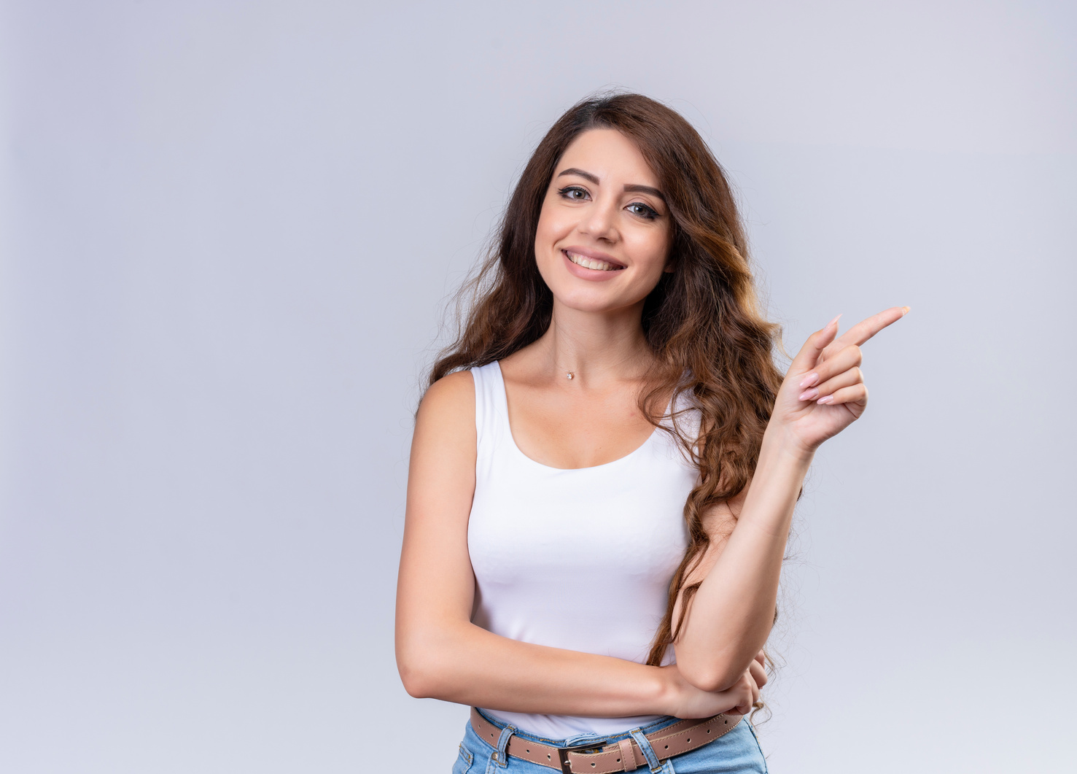
CREATIVE BRIEF
BUYER PERSONA
USER PERSONA 1
Interests | Fashion, photography, accessories, brands
Education | Media graduate
Websites | Instagram, Pinterest, TikTok
Obstacles | Worried about low-quality materials or product not matching pictures
Motivessts | Stylish brand appearance & affordable price
Online Behavior | Stylish brand appearance & affordable price
Goals via Product | Follows fashion trends and shops online regularly
NAME:
MAI
AGE:
25
CAIRO
LOCATION:
OFFICE EMPLOYEE
OCCUPATION:
MARITAL: STATUS:
SINGLE
KIDS:
NO
10.000 LE
INCOME:
LANGUAGE:
ARABIC - ENGLISH
12

Slide 13
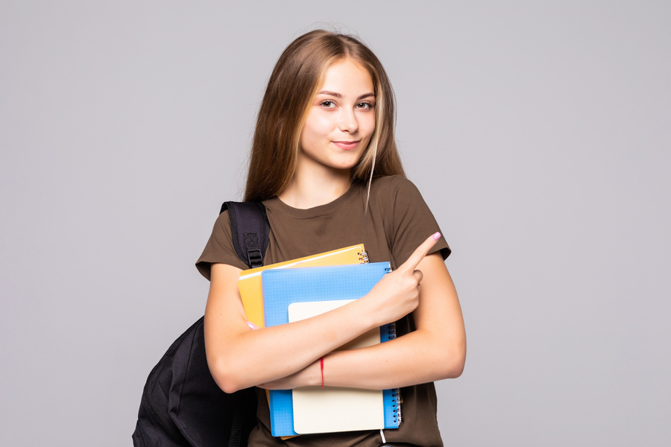
CREATIVE BRIEF
BUYER PERSONA
USER PERSONA 2
Interests | Fashion, TikTok, photography, casual wear
Education | University student
Websites | TikTok, Instagram, Shein
Obstacles | Price concerns or difficult payment options
Motivessts | Trendy look and new colors at affordable prices
Online Behavior | Buys from pages with discounts or gifts
Goals via Product | Stay trendy and stand out among friends
NAME:
ENGY
AGE:
20
TANTA
LOCATION:
STUDENT
OCCUPATION:
MARITAL: STATUS:
SINGLE
KIDS:
NO
INCOME:
MONTHLY ALLOWANCE
LANGUAGE:
ARABIC - ENGLISH
13

Slide 14
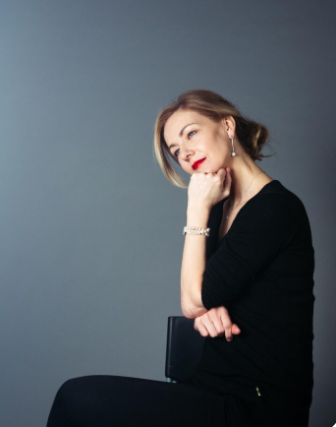
CREATIVE BRIEF
BUYER PERSONA
USER PERSONA 3
Interests | Prefer high quality , offers and deals n practical handbags for her daily essential
Education | Mass comm graduated
Websites | Noon, Amazon , Namshi , Aldo
Obstacles | Worried about low-quality materials or product not matching pictures
Motivessts | Stylish brand appearance & affordable price
Online Behavior | Stylish brand appearance & affordable price
Goals via Product | Follows fashion trends and shops online regularly
NAME:
MONA
AGE:
43
CAIRO
LOCATION:
HR SPECIALIST
OCCUPATION:
MARITAL: STATUS:
MARRIED
KIDS:
2
INCOME:
35000
LANGUAGE:
ARABIC - ENGLISH
14

Slide 15
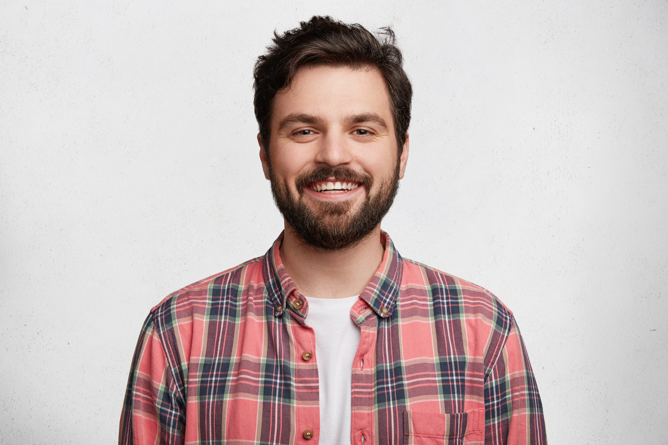
CREATIVE BRIEF
BUYER PERSONA
USER PERSONA 4
Interests | Details, careful choosing, making loved ones happy
Education | Engineering degree
Websites | Facebook, Instagram, Noon
Obstacles | Worried gift won't please or look authentic
Motivessts | Wants fancy, nicely wrapped gifts at a reasonable price
Online Behavior | Checks girls' reviews or asks sister’s opinion
Goals via Product | Choose gifts that delight his mom or fiancée
NAME:
AHMED
AGE:
27
GIZA
LOCATION:
ENGINEER
OCCUPATION:
MARITAL: STATUS:
ENGAGED
KIDS:
NO
20000
INCOME:
LANGUAGE:
ARABIC - ENGLISH
15

Slide 16

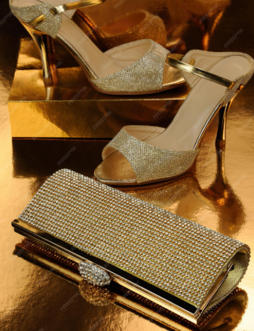
CREATIVE BRIEF
OBJECTIVES(SMART GOAL)
INCREASE INSTAGRAM FOLLOWERS BY 25%, TIKTOK FOLLOWERS BY 30%
12 POSTS, 8 REELS, AND 4 SHORT VIDEOS PER MONTH
Measurable: Increase Instagram followers by 25%, TikTok followers by 30%, and achieve at least 5,000 total engagements per month.
Specific: Create high-quality, engaging content for Instagram and TikTok: 12 posts, 50 reels, and 40 short videos per month to showcase shoes & bags.
INCREASE SALES, AND POSITION
CONTENT REVIEWS AND PERFORMANCE TRACKING
Relevant: Boosting engagement and followers will drive brand awareness, increase sales, and position Saidaty as a trendy, must-follow fashion brand.
Time-bound: Reach these targets within 3 months, with weekly content reviews and performance tracking.
16

Slide 17
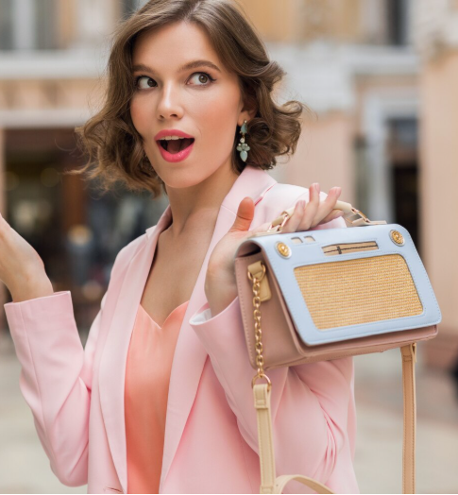
CREATIVE BRIEF
SEGMENTATION
Saidaty segments its market based on demographic, psychographic, and behavioral criteria to identify the most profitable customer groups:
- Demographic: Women aged 18–45, middle to upper-middle income level.
- Geographic: Primarily Helwan and greater Cairo with nationwide online delivery.
- Psychographic: Fashion-forward, style-conscious women seeking affordable luxury.
- Behavioral: Customers influenced by social media, following trends, and seeking coordinated fashion sets.
17

Slide 18




CREATIVE BRIEF
TARGET AUDIENCE
GENDER
PSYCHOGRAPHICS
BEHAVIOURS
Fashion-conscious individuals who care about how they look.
Like to stay updated with local and international trends.
Seek style and quality without overspending.
View bags and shoes as a reflection of their personal style.
Appreciate brands that feel authentic, elegant, and relatable.
Purchase mainly during sales seasons, holidays, and new collection launches.
Engage most with brands through Instagram and Facebook.
Prefer quick communication via WhatsApp or DMs.
Love to see coordinated looks (matching shoes + bags).
Often influenced by visuals, videos, and influencer content.
INCOME
AGE: 18-45
LOCATION: EGYPT , SAUDAI AND EMIRAT
Moderate — values quality at a fair price
18

Slide 19
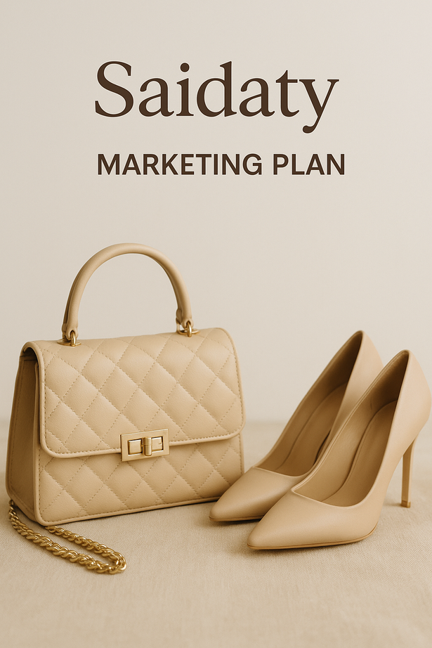
CREATIVE BRIEF
USP (UNIQUE SELLING POINT)
-Saidaty provides the latest global fashion trends in handbags and shoes — high-quality, perfectly matched sets that allow every woman to feel elegant, confident, and fashionable without overspending.
-There’s no deposite
19

Slide 20
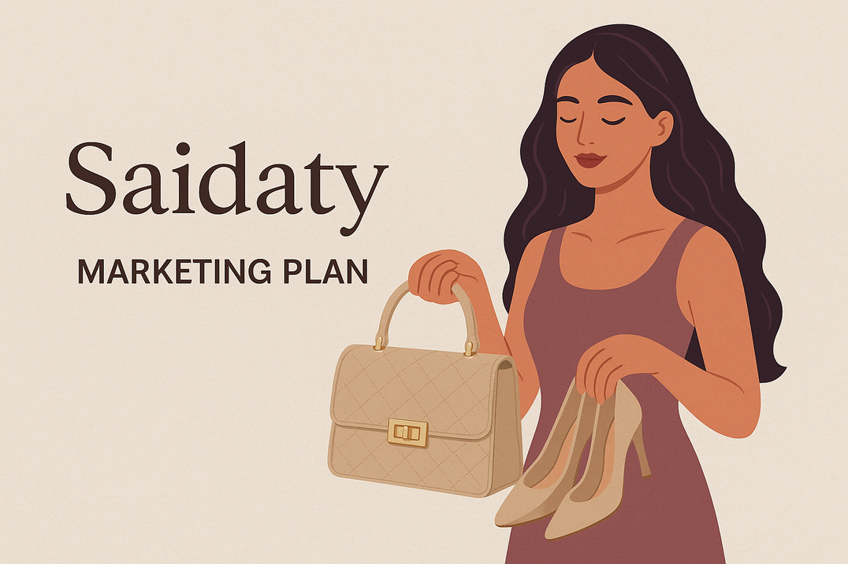
CREATIVE BRIEF
VALUE PROPOSITION
-Affordable elegance with Perfect quality.” Saidaty offers coordinated, trendy, and premium-looking products that enable women to express their personal style confidently while maintaining a reasonable budget.
20

Slide 21
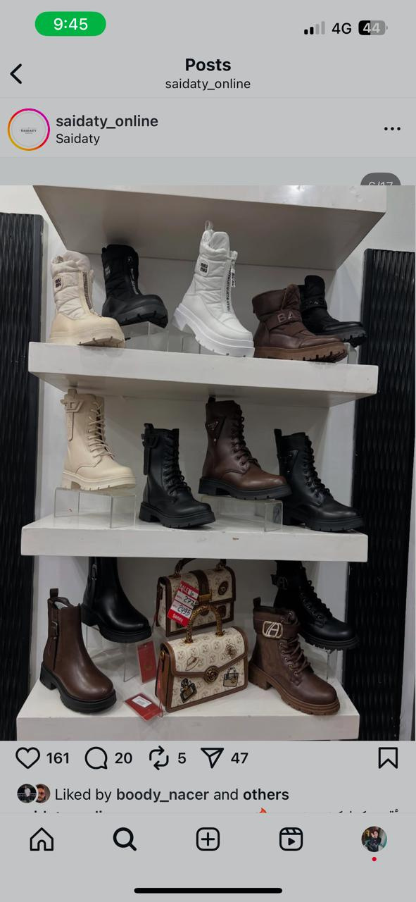
CREATIVE BRIEF
POSITIONING
Saidaty is positioned as an affordable fashion boutique that combines elegance, quality, and trendiness. The brand bridges the gap between Smart fashion and local affordability, ensuring every woman has access to international style and high-quality craftsmanship.
21

Slide 22

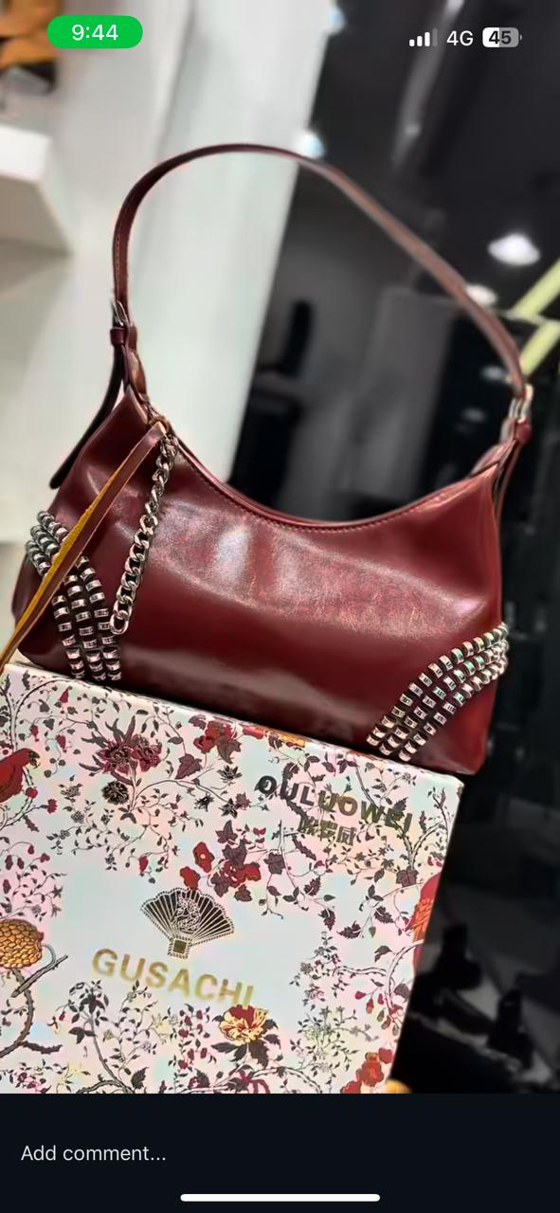
CREATIVE BRIEF
TACTICS - (4PS)
PRODUCT
PRICE
PLACE
PROMOTION
Product | - Wide range of handbags and shoes including casual, classic, and occasion wear. - Matching sets (bag + shoes) offering complete styling solutions. - High-quality high-copy products that closely resemble premium brands. - Seasonal collection updates following international trends. - over 50 professional product videos to showcase details.
Price | - Affordable pricing structure. - Seasonal promotions, bundle offers, and loyalty discounts. - Competitive pricing to appeal to both middle-income and Upper-income customers.
22

Slide 23
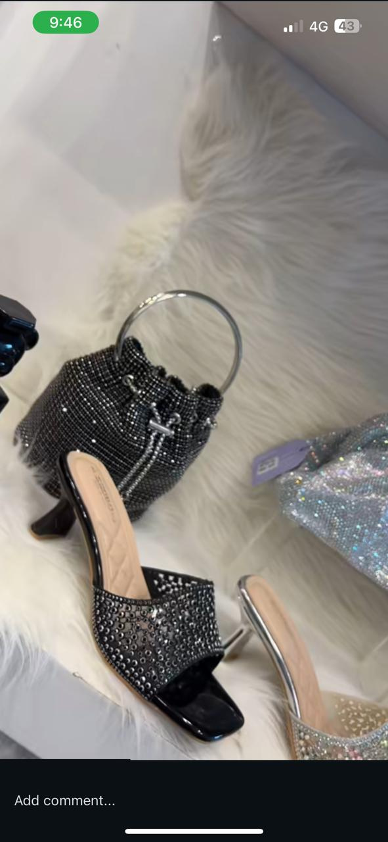
CREATIVE BRIEF
TACTICS - (4PS)
PRODUCT
PRICE
PLACE
PROMOTION
Promotion | - Social media campaigns and influencer collaborations. - Giveaways, contests, and user-generated content (#SaidatyStyle). - Ads promoting seasonal collections and matching sets.
Place | - Physical store located in Helwan. - Online sales through Instagram, Facebook, TikTok, and WhatsApp Business. -Egypt and saudi delivery and participation in fashion bazaars.
23

Slide 24
CREATIVE BRIEF
MARKETING CHANNELS
- Instagram: Core visual marketing platform for new arrivals, product styling, and influencercontent. ( Link Instagram )
- Facebook: Customer engagement, reviews, and promotions. (Link Facebook)
- TikTok: Trend-focused short-form videos showcasing collections. (Link Tiktok)
- WhatsApp Business: Direct sales, personalized customer service, and special offers.
- Offline: Store activations, bazaar participation, and loyalty engagement programs.
24

Slide 25
CREATIVE BRIEF
POSTING FREQUENCY
Instagram: 1–2 posts daily and 3–5 stories.
Facebook: 1 -2 post daily and 3-5 stories.
TikTok: 7–10 short videos weekly.
WhatsApp: 2–3 broadcasts weekly featuring new arrivals and promotions.
A structured weekly content calendar ensures consistent brand visibility.
25

Slide 26
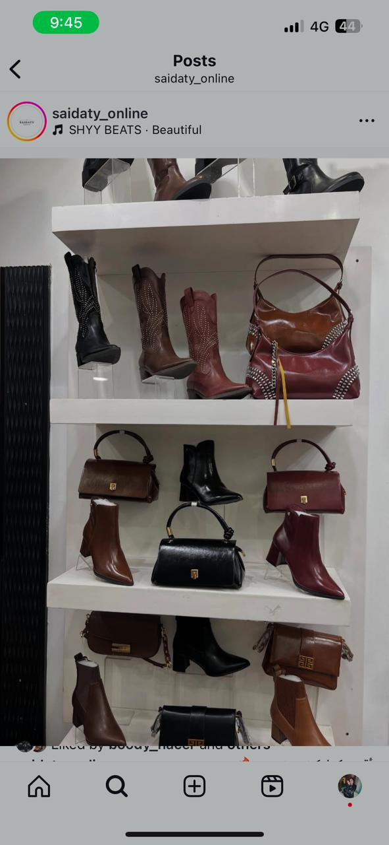
CREATIVE BRIEF
TONE OF VOICE
Saidaty’s tone of voice is friendly, elegant, confident, and relatable.
It combines simplicity with style, often using light Egyptian Arabic blended with English for a modern touch.
The communication aims to inspire customers while maintaining authenticity and warmth.
Example : “Your bag deserves to shine just like you!
Discover the new collection now.”
26

Slide 27
CREATIVE BRIEF
CONTENT CALENDAR
Content Types
· Product Photoshoots: Professional photos showing product details and styling options.
(Already shot by a professional photographer – over 50 high-quality videos and product visuals.)
· Video Reels: “How to style it” reels, unboxing, and “day in the life” videos featuring Saidaty products.
·Testimonials: Customer feedback and “before & after” transformation stories.
·Matching Sets Content: Posts showing shoes + bag combinations with outfit ideas.
CONTENT CALENDAR LINK
27

Slide 28
CREATIVE BRIEF
ACTION PLAN
Month | Activity | Responsible | Expected Outcome
1 | Define brand identity & content plan | Marketing Team | Consistent branding
2 | Launch Reels & Influencer Campaign | Social Media | Awareness boost
3 | Run seasonal offer (Ramadan/Eid) | Sales + Marketing | Sales increase
4 | Launch loyalty program | CRM | Customer retention
5 | Back to Work | Marketing Team | Engagement boost
6 | Analyze performance & adjust | Manager | Optimize strategy
28

Slide 29
CREATIVE BRIEF
CONTROL
KPIS
TOOLS
- Monthly sales growth
- Online engagement rate (likes, shares, saves)
- New vs. returning customers
- Store visit frequency
- Customer satisfaction (via Google Form / survey)
- Meta Insights
- TikTok Analytics
- Customer feedback forms
- Loyalty program data
29

Slide 30
CREATIVE BRIEF
IMPLEMENTATION PLAN
1. Visual Identity Setup
Create a clean and consistent content style, color palette, and product presentation that reflects the “semi-original but premium” positioning.
2. Product Photography
Capture high-quality product photos with clean backgrounds and multiple angles to boost ad performance and page trust
3. Social Media Content Execution
Post 10_20 times weekly:
• Product highlights
• Styling ideas
• Weekly new arrivals
30

Slide 31
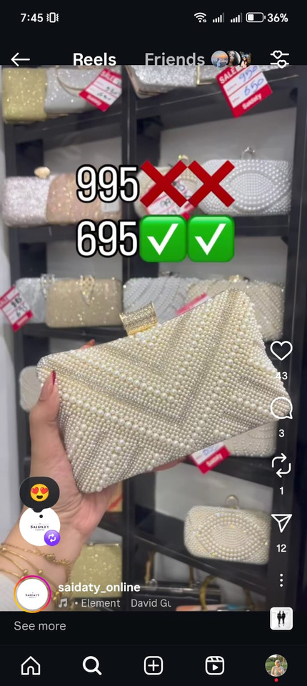
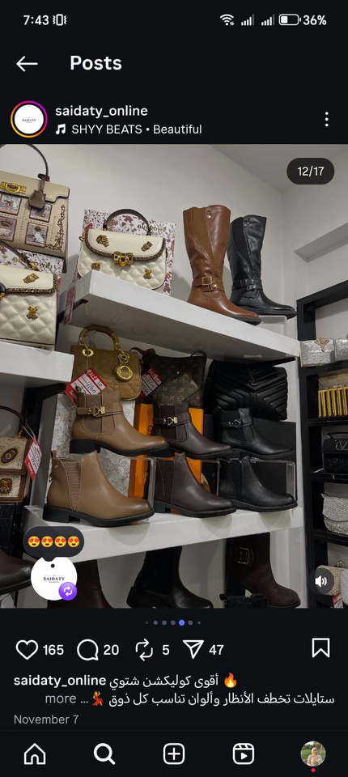
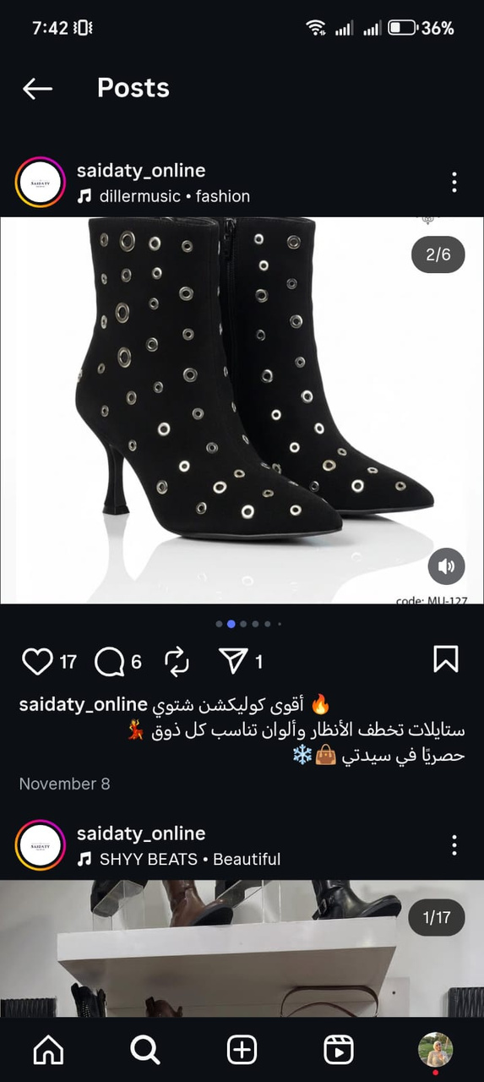
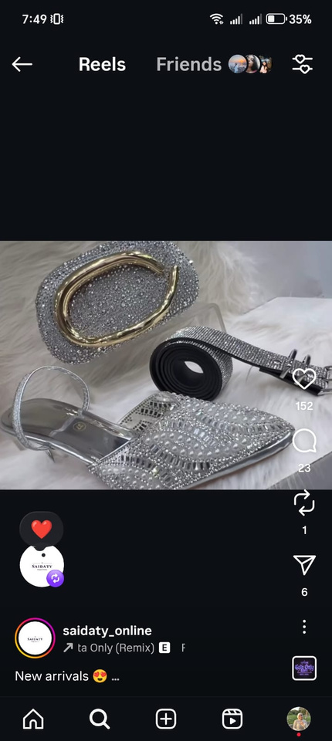
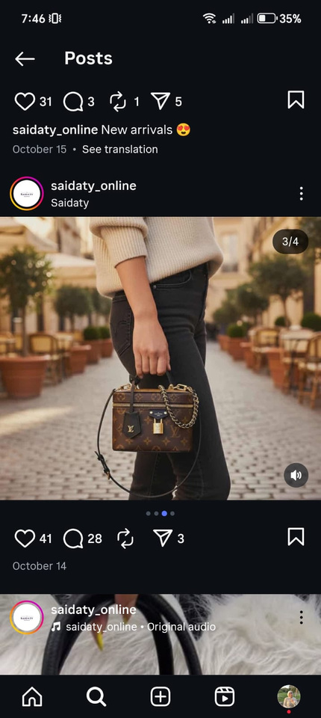
CREATIVE BRIEF
VIDEOS & POSTS
31

Slide 32
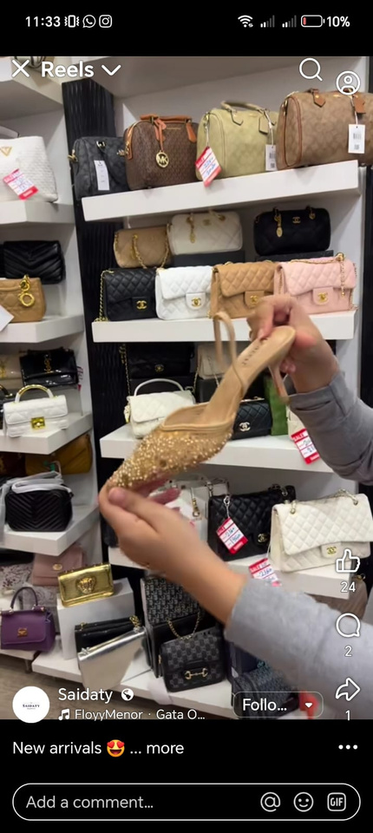
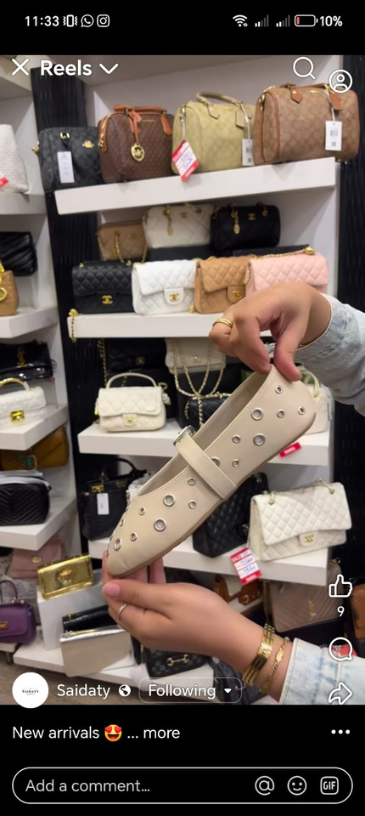
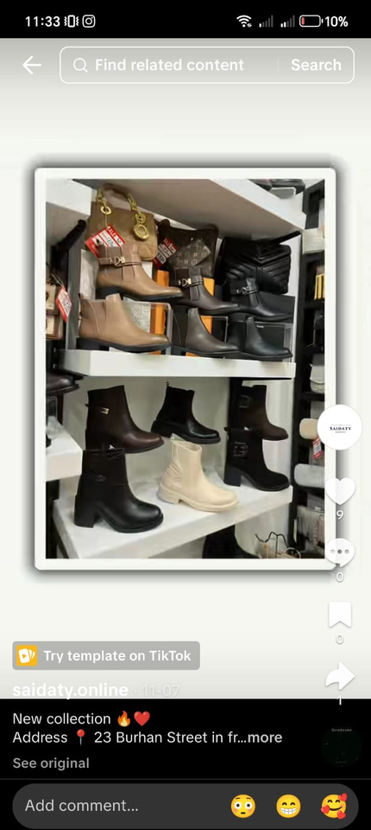
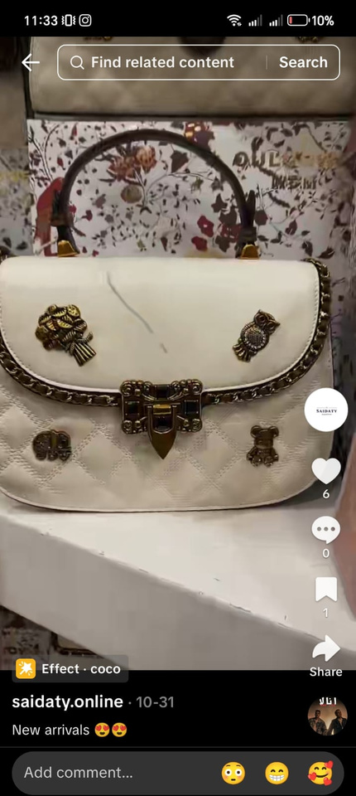
CREATIVE BRIEF
VIDEOS & POSTS
GO TO THE VIDEO
32

Slide 33
CREATIVE BRIEF
STATISTICS
Period: October 12 to November 13:
· Facebook: followers increased from 45,000 → 49,000 (growth rate: 8.9%)
· Instagram: followers increased from 22,300 → 24,600 (growth rate: 10.3%)
· TikTok: followers increased from 3,744 → 4,068 (growth rate: 8.6%)
· Overall platforms growth rate: approximately 9.2%
34

Slide 34
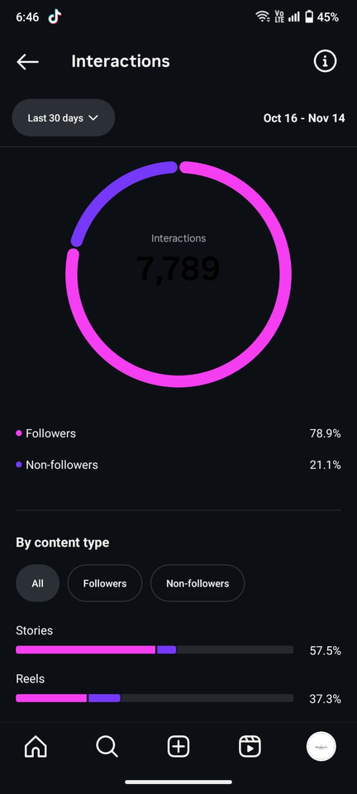
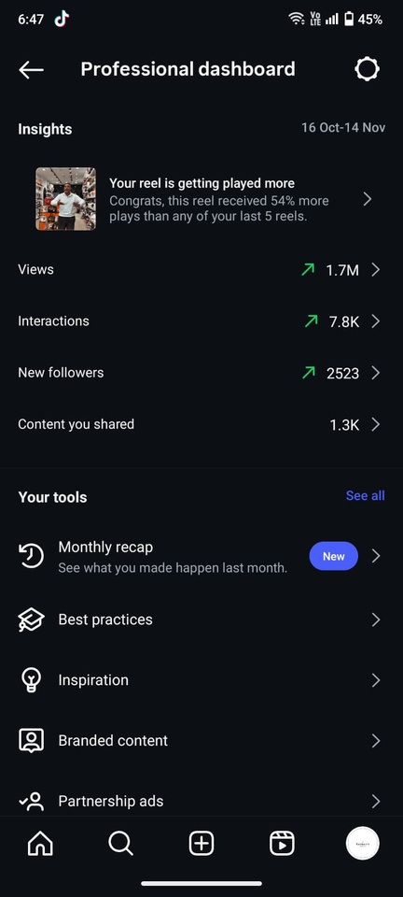
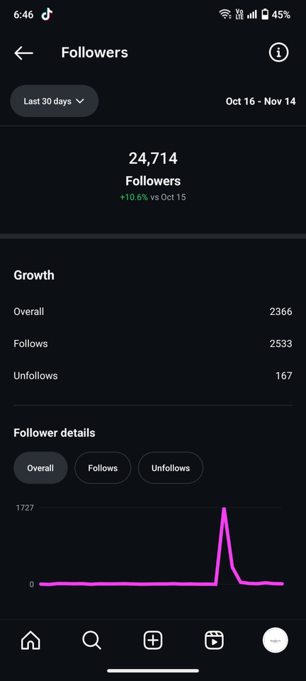
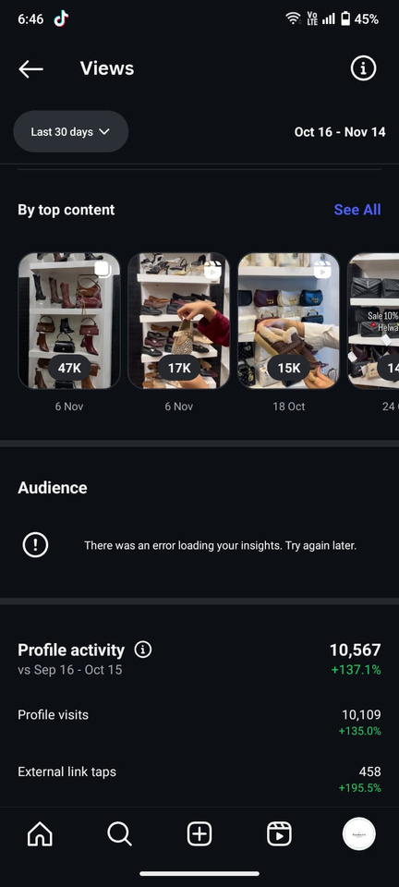
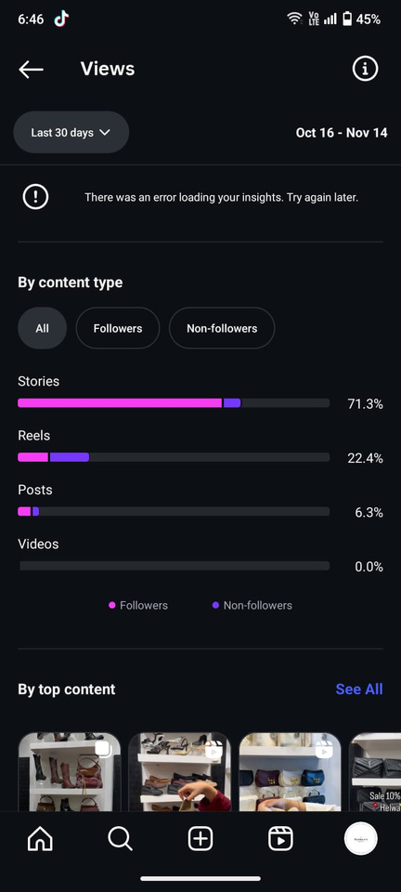
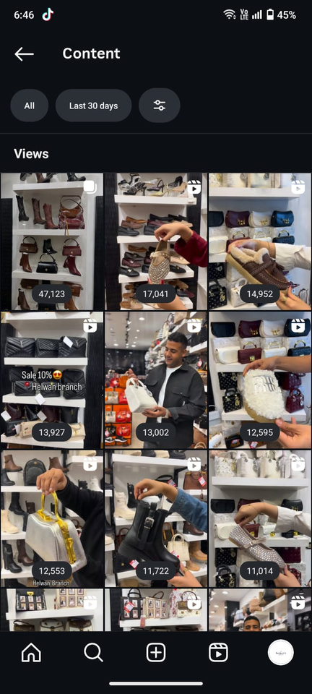
CREATIVE BRIEF
INSTAGRAM STATISTICS
35

Slide 35
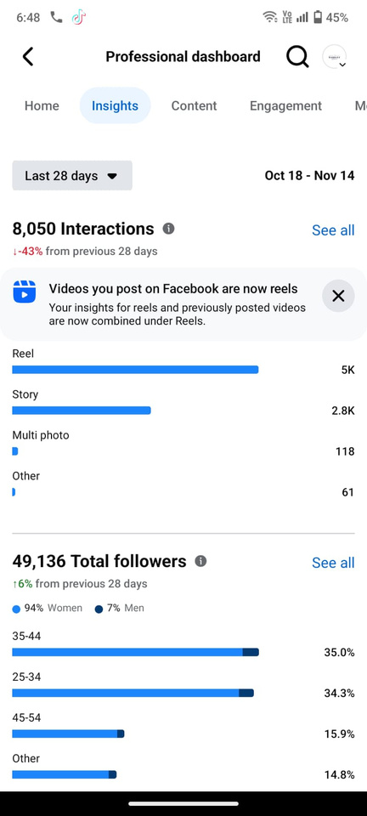
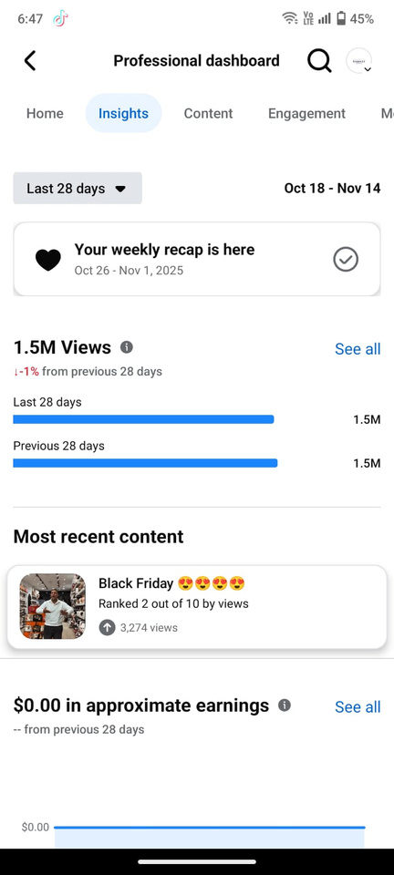
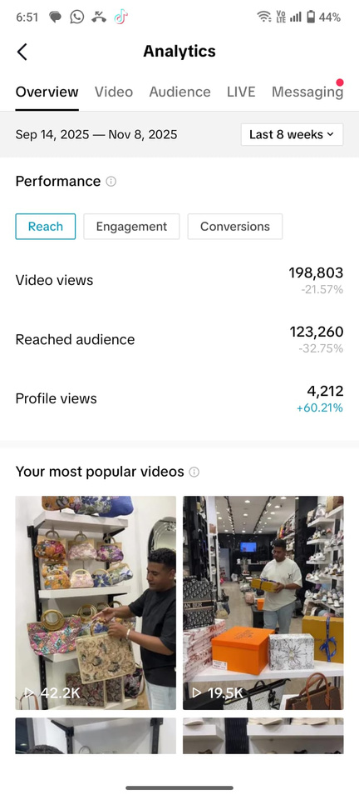
CREATIVE BRIEF
FACEBOOK STATISTICS
36

Slide 36
CREATIVE BRIEF
RECOMMENDATIONS
· Implement a loyalty points system for regular customers to encourage repeat purchases.
· Enhance customer experience by adding clear descriptions and multiple images for each product.
· Targeted marketing through ads based on interests and focusing on best-selling products.
· Create a website for direct sales.
· Focus on customer interaction:
1- Respond to comments promptly.
2- Collaborate with influencers.
3- Increase promotions and discounts.
33

Slide 37
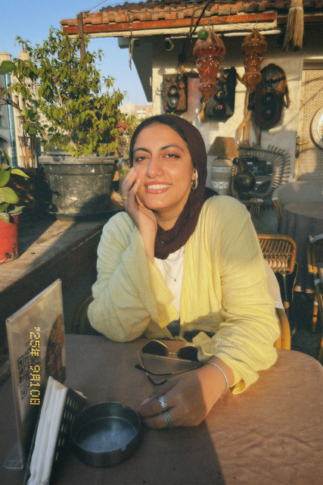
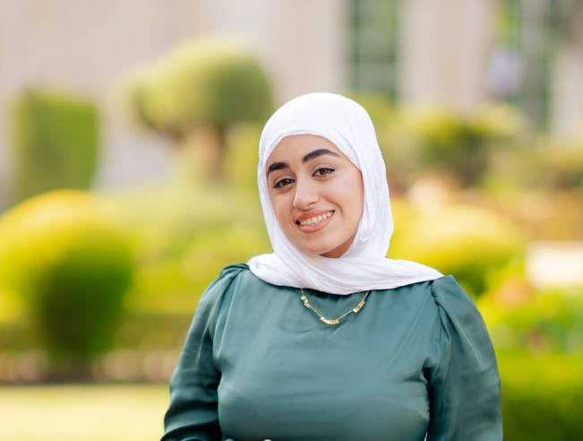
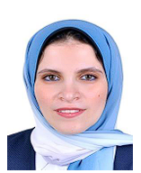
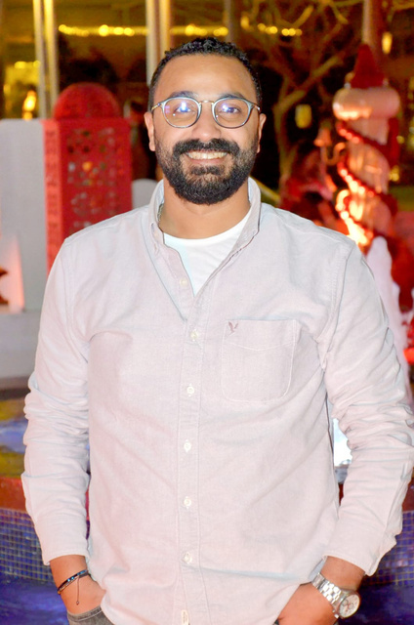
CREATIVE BRIEF
-
Meet
Our
Team
Team Leader
Samaa Omar
RAHMA ZAKI
Dina Fadel
Ahmed Nagy
37

